Slide 1

Green Pace
Security Policy Presentation
Developer: Chris Grey
Notes:
Hi, I'm Chris Grey, and this presentation covers the security policy I developed for Green Pace in CS405.
I'll go over the ten secure coding standards included in the policy, how I prioritized different security risks, and how testing and automation can help identify vulnerabilities before software is released.
I'll also cover encryption, access controls, and some recommendations for keeping the policy effective as Green Pace's development team continues to grow.

Slide 2

OVERVIEW: DEFENSE IN DEPTH
Consistent Practices: Gives Green Pace developers the same security guidelines to follow as the team grows.
Catch Problems Early: Uses secure coding standards and testing to identify potential vulnerabilities before software is released.
Defense in Depth: Combines secure coding, testing, encryption, access controls, and monitoring so security does not depend on just one layer of protection.
Notes:
The main reason for this security policy is to make sure Green Pace developers are following the same security practices as the team continues to grow. Without clear standards, different developers might handle the same security problems in different ways, or security checks could get pushed until the end of development.
Defense in depth means we shouldn't depend on just one security measure to catch everything. For example, developers can follow secure coding standards and validate inputs, while automated analysis and unit testing can help identify problems before the software is released.
Beyond the code itself, things like encryption, access controls, and monitoring provide additional protection. The illustration shows multiple layers of security working together to protect important systems and information, rather than relying on one solution.
The idea is that if one layer misses a vulnerability, another layer might catch it or at least help reduce the impact.
Green Pace's attack surface includes places where outside input can reach an application, such as web forms, APIs, network connections, and database requests. Even with secure coding practices in place, we have to assume vulnerabilities could still exist, which is why having multiple layers of protection is important.

Slide 3
THREATS MATRIX
The ten coding standards are grouped by threat level based on Green Pace's risk assessment. Higher levels indicate greater security risk.
Level 5: Highest Threat STD-002-CPP: Signed Integer Overflow STD-009-CPP: Safe String Creation from Pointers | Level 4: High Threat STD-003-CPP: Safe String Storage STD-004-CPP: SQL Injection Prevention STD-005-CPP: Use-After-Free Prevention STD-010-CPP: Proper Dynamic Memory Deallocation
Level 2: Lower Threat STD-001-CPP: Safe Integer Conversions STD-007-CPP: Exception Handling STD-008-CPP: Divide-by-Zero Prevention | Level 1: Lowest Threat STD-006-CPP: Safe Use of Assertions
Notes:
This matrix shows the ten coding standards from Green Pace's security policy, grouped by their assigned threat levels. These ratings consider how serious each vulnerability could be and how likely it is to occur. The priority ratings also consider things like remediation costs and which problems should be addressed first.
At level 5, the highest threat level, I placed signed integer overflow and unsafe string creation from pointers. Both were assessed as high severity and likely to occur. Integer overflow can lead to unpredictable calculations, while creating a string from a null pointer can cause undefined behavior.
Level 4 includes safe string storage, SQL injection prevention, use-after-free prevention, and proper dynamic memory deallocation. These can also create serious security problems, including unauthorized access to information and unsafe memory operations. However, their remediation costs and overall risk assessments placed them in the Medium priority group.
Level 2 includes safe integer conversions, exception handling, and divide-by-zero prevention. Unsafe integer conversions were considered high severity but less likely to occur, which is why they still received High priority despite the lower threat level. Exception handling and divide-by-zero prevention received lower severity ratings.
Safe use of assertions received Level 1 because it was assessed as low severity, unlikely to occur, and Low priority. That doesn't mean developers should ignore it, just that other vulnerabilities would generally need attention first.
No standards received a Level 3 rating.
The important thing to remember is that threat levels and remediation priorities aren't exactly the same. The matrix helps Green Pace understand the risks, while the priority ratings help developers decide where to focus their efforts.

Slide 4
10 PRINCIPLES
1. Validate Input Data
STD-001-CPP, STD-002-CPP, STD-004-CPP, STD-008-CPP, STD-009-CPP
2. Heed Compiler Warnings
STD-001-CPP
3. Architect and Design for Security Policies
Broader policy principle
4. Keep It Simple
STD-003-CPP, STD-005-CPP, STD-006-CPP, STD-010-CPP
5. Default Deny
Broader policy principle
6. Adhere to the Principle of Least Privilege
Broader policy principle
7. Sanitize Data Sent to Other Systems
STD-004-CPP
8. Practice Defense in Depth
STD-007-CPP
9. Use Effective Quality Assurance Techniques
STD-002-CPP, STD-005-CPP, STD-006-CPP, STD-007-CPP, STD-008-CPP, STD-009-CPP
10. Adopt a Secure Coding Standard
STD-003-CPP, STD-010-CPP
Notes:
These ten security principles provide the foundation for Green Pace's secure coding standards. Each principle addresses a different part of security, and some coding standards support more than one principle, which is why certain standards appear in multiple places.
The first principle is validating input data. This connects to several standards, including checking integer values before calculations, preventing SQL injection, checking for divide-by-zero conditions, and making sure pointers are valid before using them.
The second principle is paying attention to compiler warnings. This connects to safe integer conversions because the compiler may warn developers about values being converted between different data types.
Other principles focus on designing security into applications from the beginning and keeping code simple. Keeping things simple supports standards involving string storage, memory management, and assertions because code that's easier to understand is generally easier to test and troubleshoot.
Default deny and least privilege are broader security principles that focus on controlling access. They don't directly match one of the ten individual coding standards, but they're still important. For example, even if developers follow the SQL injection prevention standard, the application's database account should only have the permissions it actually needs. That helps limit the damage if something goes wrong.
Sanitizing data sent to other systems connects to SQL injection prevention, while defense in depth also supports proper exception handling. Handling errors correctly gives a program another opportunity to respond safely when something unexpected happens.
The last two principles focus on effective quality assurance and adopting secure coding standards. Testing, code reviews, and automated analysis help developers identify problems involving calculations, memory, and exception handling that they might otherwise miss.
The goal is to make security part of everyday development instead of something that only gets checked right before software is released.

Slide 5
CODING STANDARDS
HIGH PRIORITY
1. STD-002-CPP: Signed Integer Overflow (Level 5)
2. STD-009-CPP: Safe String Creation from Pointers (Level 5)
3. STD-001-CPP: Safe Integer Conversions (Level 2)
MEDIUM PRIORITY
4. STD-003-CPP: Safe String Storage (Level 4)
5. STD-004-CPP: SQL Injection Prevention (Level 4)
6. STD-005-CPP: Use-After-Free Prevention (Level 4)
7. STD-010-CPP: Proper Dynamic Memory Deallocation (Level 4)
8. STD-007-CPP: Exception Handling (Level 2)
9. STD-008-CPP: Divide-by-Zero Prevention (Level 2)
LOW PRIORITY
10. STD-006-CPP: Safe Use of Assertions (Level 1)
Notes:
This slide lists the ten coding standards from Green Pace's security policy, organized by priority. I considered the severity of each vulnerability, how likely it is to occur, the cost of correcting it, and how urgently it should be addressed.
The threat level represents the overall risk assessment, while the priority rating helps developers decide which problems to address first. That's why the two ratings don't always match.
The High-priority standards are signed integer overflow, safe string creation from pointers, and safe integer conversions.
For integer overflow, developers need to check that calculations won't exceed the supported integer range. When creating strings from pointers, they should verify that the pointer isn't null before using it. Both received Level 5 threat ratings because they can lead to undefined behavior and other serious problems. Safe integer conversions received High priority at Level 2 because converting values without checking their range can lead to unexpected results.
The Medium priority group includes six standards.
Safe string storage means providing enough space for the characters and null terminator to prevent buffer overflows. SQL injection prevention involves using parameterized queries so user input can't change the intended SQL command.
Use-after-free prevention means not accessing memory after it's been released. Proper dynamic memory deallocation means cleaning up allocated memory correctly, such as matching new[] with delete[]. These four standards received level 4 threat ratings.
Exception handling and divide-by-zero prevention are also Medium priority, but at level 2. Developers should properly handle exceptions instead of ignoring errors and check the denominator before dividing to prevent invalid calculations.
The Low-priority standard is safe use of assertions, rated Level 1. Assertions are useful for finding programming mistakes during testing, but they shouldn't replace normal error handling. For example, a program should handle a file that fails to open rather than relying on an assertion.
These priorities don't mean that lower-rated standards can be ignored. They help Green Pace focus on the most important problems first while still requiring developers to follow all ten standards.

Slide 6
ENCRYPTION POLICIES
ENCRYPTION IN FLIGHT
Require HTTPS/TLS when transmitting sensitive information between systems, applications, and APIs.
Encrypt internal and external network traffic to help prevent interception of data and credentials.
ENCRYPTION AT REST
Encrypt sensitive data stored on servers, databases, laptops, and backups.
Protect encryption keys separately and restrict access to authorized users and services.
Reduces exposure if devices or stored information are compromised.
ENCRYPTION IN USE
Limit access to sensitive data while applications are actively processing it.
Follow least-privilege permissions and minimize how long decrypted information remains exposed in memory.
Use additional processing protections where supported.
Notes:
Encryption is another important part of Green Pace's security policy because sensitive information needs to be protected whether it's being transferred, stored, or actively used.
Encryption in flight protects information while it's moving between systems. For example, when an application sends information through an API, the connection should use a secure protocol like TLS. This applies to internal network traffic too, since we shouldn't assume everything inside the company network is safe. The goal is to prevent sensitive information or credentials from being intercepted.
Encryption at rest protects stored information, including databases, servers, laptops, and backups. Green Pace should encrypt sensitive data, protect encryption keys separately, and limit access to authorized users. This helps reduce the damage if a laptop is stolen or someone gains unauthorized access to stored information.
Protecting data while it's in use is a little different. Applications often need to decrypt information before processing it, which means sensitive data may temporarily be exposed in memory. Green Pace should limit access, follow least-privilege permissions, and keep decrypted information exposed for as little time as possible. Additional memory protections or hardware-supported encryption can also help where available.
All three are important because protecting information in one situation doesn't necessarily mean it's protected in another. Together, they provide additional layers of security for Green Pace.

Slide 7
TRIPLE-A POLICIES
AUTHENTICATION
Verify the identity of users, applications, and services before allowing access.
Require unique user accounts, secure login methods, and multifactor authentication when available.
Verify and approve new users before creating accounts to help prevent unauthorized access.
AUTHORIZATION
Assign access based on job responsibilities and the principle of least privilege.
Restrict sensitive files, databases, and administrative tools to approved users.
Review permissions when accounts are created, job roles change, or access is no longer needed.
ACCOUNTING
Log user sign-ins, failed login attempts, new accounts, and permission changes.
Record database activity and access to sensitive files to support security investigations.
Review logs for suspicious activity and protect records from unauthorized changes.
Notes:
The Triple-A framework includes authentication, authorization, and accounting. These three policies help Green Pace control who can access its systems, what they're allowed to do, and how their activity is tracked.
Authentication verifies that a user or application is who it claims to be. Green Pace should require unique user accounts, secure login methods, and multifactor authentication when available. New users should also be verified and approved before their accounts are created. This helps prevent unauthorized access, especially if someone's credentials are stolen.
Authorization determines what someone can access after signing in. Having a valid account doesn't mean a person should have access to everything. Green Pace should follow the principle of least privilege, giving employees and applications only the permissions they need.
For example, someone who only needs to view information shouldn't automatically have permission to modify a database or change system settings. Permissions should also be reviewed when someone changes job roles or no longer needs access.
Accounting focuses on recording activity within the system. This includes successful and failed logins, new accounts, permission changes, database activity, and access to sensitive files.
Green Pace already has operating system, firewall, and anti-malware logging in place, so this policy builds on those existing protections. Logs should be reviewed for suspicious activity and protected against unauthorized changes.
Together, these three policies help Green Pace verify identities, limit access, and investigate problems when something goes wrong.

Slide 8
Unit Testing
Up Next: Testing the Code
Six C++ unit tests completed in Visual Studio.
Each following slide presents one test with its code and results.
We'll review what each test checks, whether it passed, and why the results matter for secure coding.
Notes:
Next, I'll go over the unit testing portion of this project. I used Visual Studio's C++ Unit Test Framework to complete six tests and verify that the code behaves the way it's supposed to.
Unit testing is useful because it allows developers to check individual parts of a program against expected results. These tests can also be run again after making changes to help catch problems before software is released.
Each of the next six slides shows one test, including the code and the results from Visual Studio. I'll explain what each test checks, whether it passed, and why the results matter for secure coding.

Slide 9
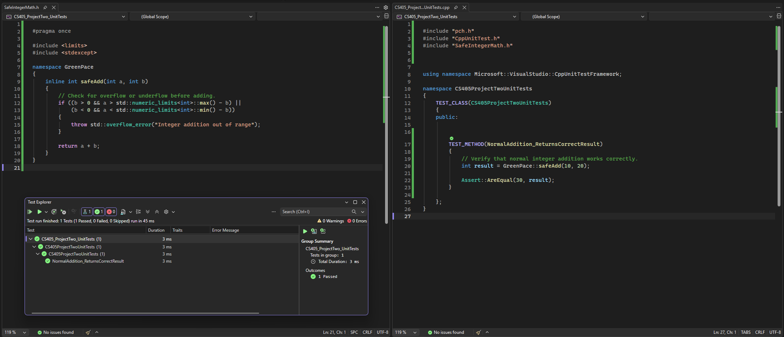
Does Normal Addition Return the Expected Result?
Test: Verify that safeAdd(10, 20) returns the expected value of 30.
Result: PASSED. Visual Studio confirmed the function returned the correct sum.
Notes:
For these tests, I focused on signed integer overflow because it was one of the highest-rated risks in Green Pace's security policy. I created a C++ function called safeAdd that checks whether two integers can be added safely before performing the calculation.
For this first test, I wanted to make sure those security checks didn't interfere with normal addition. I passed 10 and 20 into safeAdd and expected the result to be 30.
In Visual Studio, I used Assert::AreEqual to compare the actual result with the expected value. As shown in the screenshot, the test passed and returned the correct answer.
This might seem like a basic test, but it's still important. We don't want to prevent an overflow by accidentally rejecting calculations that are perfectly safe.
To take this a step further, I could test other valid inputs, like adding zero or using different positive numbers, to make sure the function continues working correctly.

Slide 10
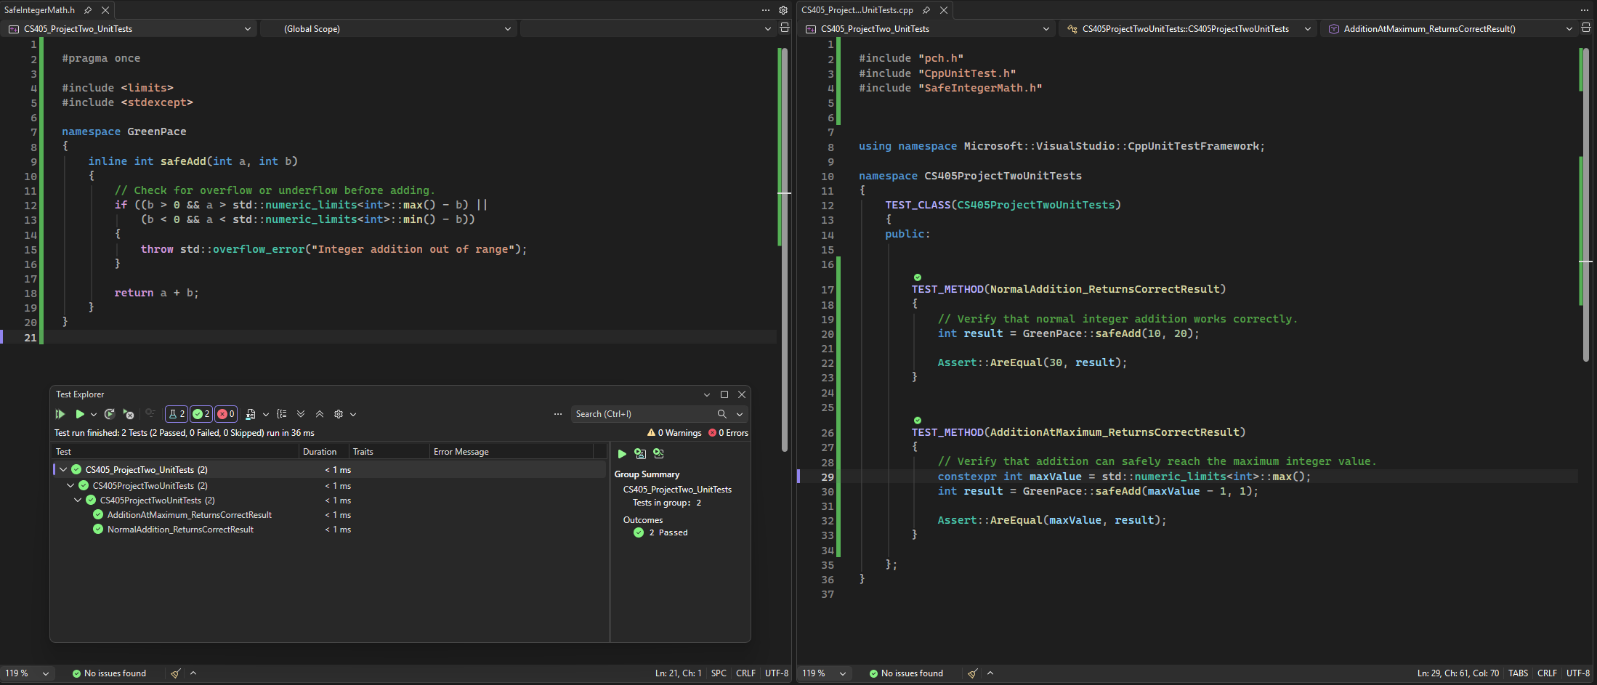
Can Addition Safely Reach the Maximum Integer Value?
Test: Verify that safeAdd() allows a calculation that reaches INT_MAX without exceeding the signed integer range.
Result: PASSED. The function returned the maximum valid integer value without throwing an exception.
Notes:
For the second test, I wanted to see how safeAdd handles a calculation right at the upper limit of a signed integer.
I started with INT_MAX minus one and added one. The expected result was INT_MAX, which represents the largest value a signed integer can hold.
I used Assert::AreEqual again to compare the actual result with what I expected. As shown in Visual Studio, the test passed, meaning safeAdd handled the calculation correctly without treating it as an overflow.
This is important because we want the function to recognize the difference between a calculation that's still valid and one that actually exceeds the limit. Being close to the maximum value shouldn't automatically cause an error.
To expand this test, I could try other combinations of positive numbers that add up to INT_MAX and make sure they produce the same result.

Slide 11
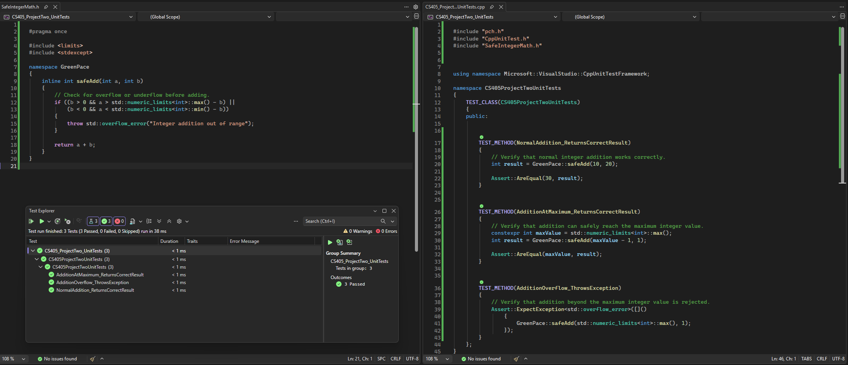
Does the Function Prevent Signed Integer Overflow?
Test: Verify that safeAdd() detects an addition that would exceed INT_MAX and throws an exception instead.
Result: PASSED. The function correctly rejected the unsafe calculation by throwing a std::overflow_error exception.
Notes:
For the third test, I wanted to see what happens when a calculation actually exceeds the maximum value a signed integer can hold.
This time, I passed INT_MAX and one into safeAdd. Since INT_MAX is already the largest possible value, adding one would cause an integer overflow if the calculation wasn't handled properly.
Instead of expecting a numerical result, I used Assert::ExpectException to verify that the function throws an overflow error.
As shown in Visual Studio, the test passed. In this case, passing means the function correctly detected the unsafe calculation and threw the expected exception instead of allowing the overflow to occur.
This is especially important from a security standpoint because integer overflows can lead to unexpected program behavior and potentially create vulnerabilities.
To expand this test, I could try adding other positive values to INT_MAX or test calculations that exceed the limit by different amounts to make sure the protection works consistently.

Slide 12
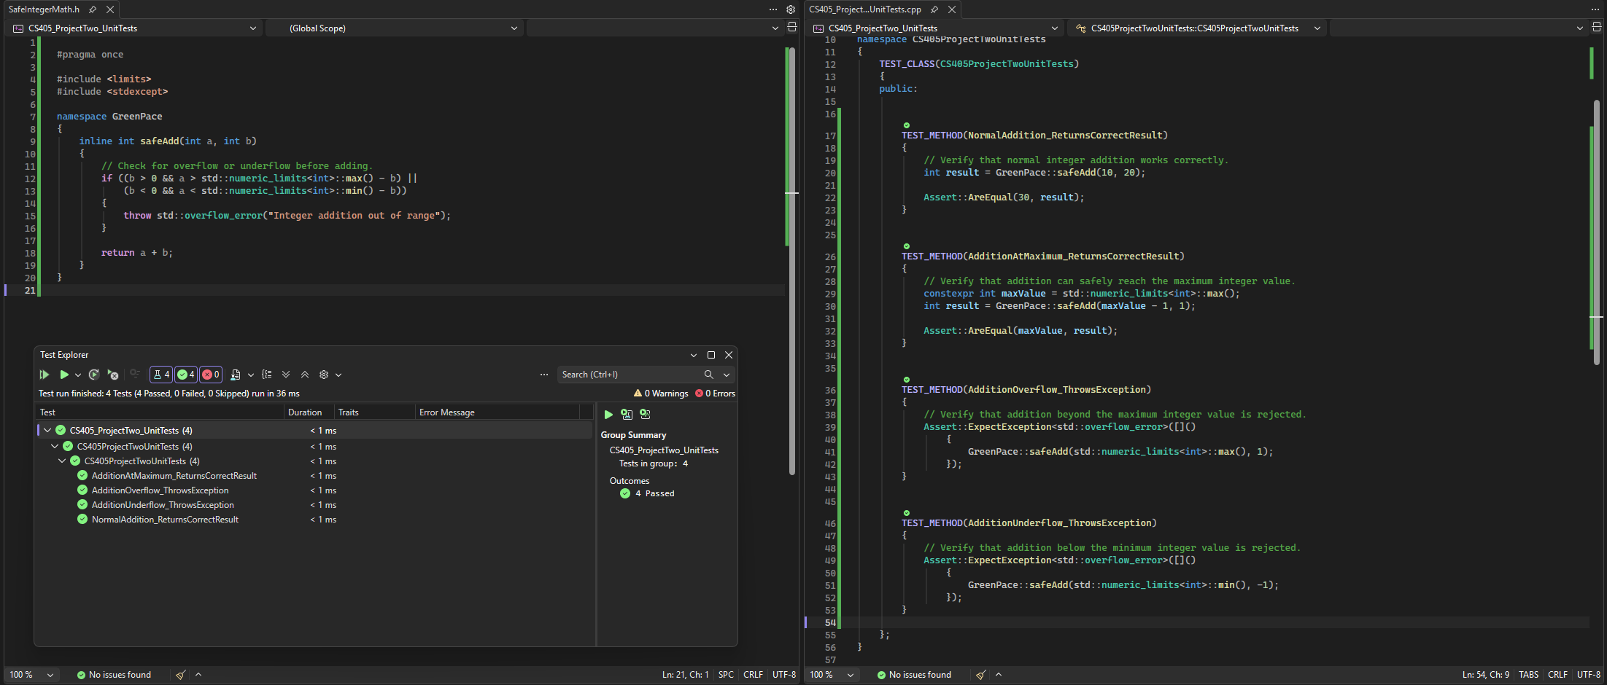
Does the Function Prevent Signed Integer Underflow?
Test: Verify that safeAdd() detects an addition that would fall below INT_MIN and throws an exception instead.
Result: PASSED. The function correctly rejected the unsafe calculation by throwing a std::overflow_error exception.
Notes:
For the fourth test, I wanted to check the opposite end of the signed integer range and make sure safeAdd also protects against underflow.
This time, I passed INT_MIN and negative one into safeAdd. INT_MIN represents the smallest value a signed integer can hold, so adding negative one would push the result below that limit.
Just like the previous test, I used Assert::ExpectException to verify that the function throws an overflow error instead of allowing the calculation to continue.
As shown in Visual Studio, the test passed. This means safeAdd correctly detected that the result would fall below the minimum value and threw the expected exception.
This is important because checking only the maximum limit isn't enough. The function also needs to protect against calculations that go below the minimum value.
To expand this test, I could try adding other negative values to INT_MIN and make sure the protection works consistently.

Slide 13
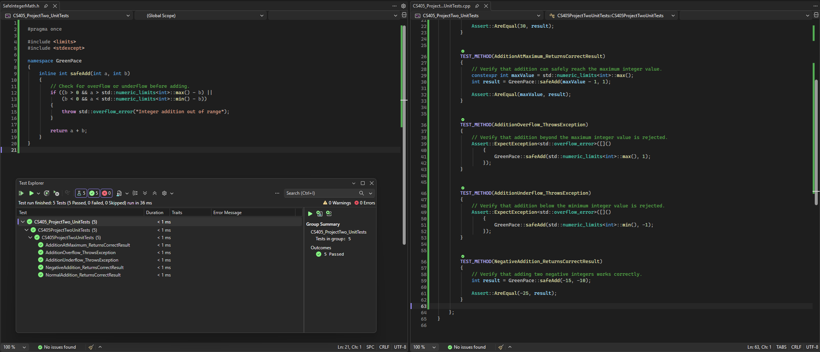
Does the Function Correctly Add Negative Integers?
Test: Verify that safeAdd() correctly adds negative integers when the result remains within the valid signed integer range.
Result: PASSED. The function returned the expected negative sum without throwing an exception.
Notes:
For the fifth test, I wanted to make sure safeAdd could handle negative numbers correctly without treating every negative result as an underflow.
I passed negative 15 and negative 10 into safeAdd, expecting the result to be negative 25. Since this calculation is well within the valid integer range, the function should complete it normally.
I used Assert::AreEqual to compare the actual result with the expected value. As shown in Visual Studio, the test passed and returned negative 25.
This test is important because adding two negative numbers doesn't automatically mean there's a problem. We want the function to prevent unsafe calculations while still allowing valid ones, even when the result is negative.
To expand this test, I could try other negative values or mix positive and negative numbers to make sure safeAdd handles the different combinations correctly.

Slide 14
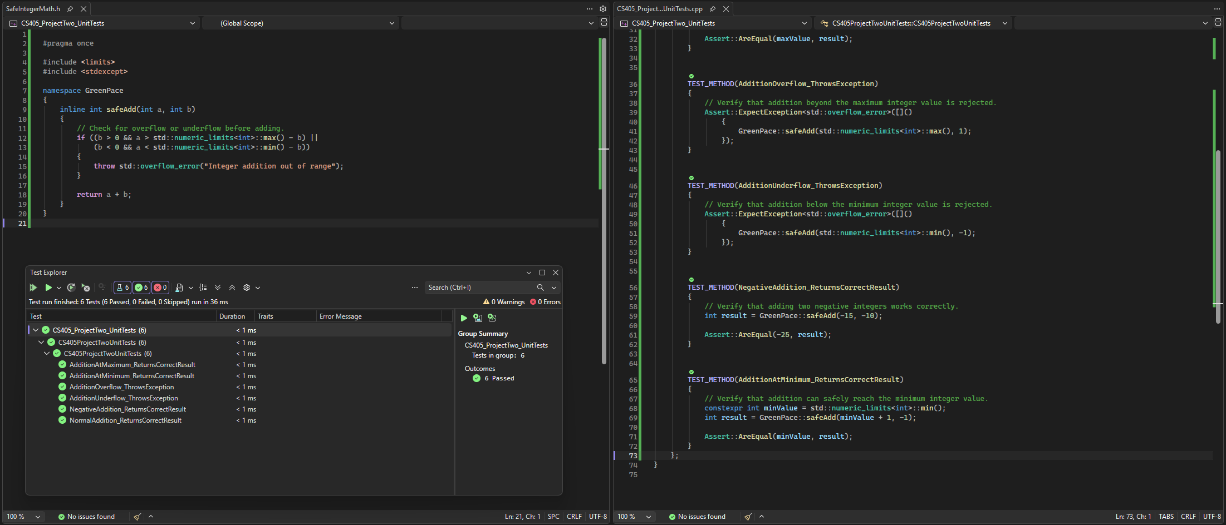
Can Addition Safely Reach the Minimum Integer Value?
Test: Verify that safeAdd() allows a calculation that reaches INT_MIN without falling below the valid signed integer range.
Result: PASSED. The function returned the minimum valid integer value without throwing an exception.
Notes:
For the sixth and final test, I wanted to make sure safeAdd could handle a calculation that reaches the minimum signed integer value without going below it.
I started with INT_MIN plus one, then added negative one. The expected result was INT_MIN, which is the smallest value a signed integer can hold.
I used Assert::AreEqual to compare the actual result with what I expected. As shown in Visual Studio, the test passed, meaning safeAdd returned the correct value without throwing an exception.
This is similar to the maximum boundary test from earlier. We want the function to prevent calculations that exceed the allowed range, but it should still accept calculations that reach those limits exactly.
To expand this test, I could try other combinations of numbers that produce INT_MIN or test values just above the minimum to make sure safeAdd continues handling valid calculations correctly.
With all six tests passing, I've confirmed that the function handles the specific normal, boundary, and overflow conditions I tested.

Slide 15

AUTOMATION SUMMARY
Notes:
Now that I've covered the six unit tests, I want to explain how Green Pace could build testing and other security checks into its normal development process instead of waiting until the software is finished.
The diagram shows how security fits into both pre-production and production. During planning and design, the team should identify potential threats and determine which coding standards apply before development begins.
As developers start writing code, automated static analysis can help identify potential vulnerabilities early. I used Visual Studio and Cppcheck earlier in this course, so those are examples of tools Green Pace could incorporate into its development process.
During the build and testing stages, the compiler checks for errors and warnings, while automated unit tests verify that the code behaves as expected. For example, the six tests I just demonstrated could be included in an automated test suite. If a serious security issue is found, it should be corrected or reviewed before the software moves forward.
Before deployment, the team should also verify that the required security checks have passed and that the system is configured correctly.
Once the software reaches production, logging and monitoring can help identify suspicious activity or problems that weren't caught earlier. If something does go wrong, the team can investigate, respond, and use what they learned to improve future development.
The main idea is that no single tool will catch every vulnerability. By including security checks throughout the process, Green Pace has multiple opportunities to identify problems before they become more serious.

Slide 16
TOOLS
CODE DEVELOPMENT AND REVIEW (PRE-PRODUCTION)
Visual Studio Static Analysis and Cppcheck: Identify potential coding vulnerabilities and other issues during development and code review.
Proposed tools: Astrée for signed integer overflow and CodeSonar for issues such as SQL injection.
BUILD AND TESTING (PRE-PRODUCTION)
C++ compiler: Identifies compilation errors and warnings during the build process.
Visual Studio C++ Unit Test Framework: Verifies expected behavior and confirms that unsafe calculations are rejected.
Automated checks should run before release, with high-risk findings requiring correction or review.
DEPLOYMENT AND MONITORING (PRODUCTION)
Existing operating system, firewall, and anti-malware logs help identify suspicious activity.
Security monitoring and alerts support investigations, while findings help improve future development.
Notes:
This slide covers some of the tools Green Pace could use to help enforce its secure coding standards throughout development.
During development and code review, Visual Studio's static analysis tools and Cppcheck can help identify potential problems, such as unsafe memory access, buffer issues, and uninitialized variables. I used both of these earlier in the course, so I've had some experience seeing how they can identify problems in C++ code.
Green Pace could also consider additional tools, like Astrée for signed integer overflow and CodeSonar for issues such as SQL injection. These would be recommendations rather than tools I personally tested for this project.
One thing I think is important is connecting the findings back to the actual coding standards. For example, a possible signed integer overflow would relate to STD-002-CPP, while unsafe string creation from a null pointer would relate to STD-009-CPP.
Each standard should have some way to verify compliance, whether that's through automated analysis, unit testing, or manual code review. Automated tools are useful, but they won't catch everything.
During the build stage, compiler warnings and automated unit tests provide additional opportunities to catch problems before release. Any serious findings should be corrected or reviewed before moving forward.
Once software reaches production, Green Pace can also use its existing operating system, firewall, and anti-malware logs to help identify suspicious activity.
Using these tools together gives Green Pace several opportunities to catch security problems and helps developers understand which standards need attention.

Slide 17
AUTOMATED DETECTION BY CODING STANDARD
Coding Standard | Proposed Detection Tool
STD-001-CPP: Safe Integer Conversions | CodeSonar
STD-002-CPP: Signed Integer Overflow | Astrée
STD-003-CPP: Safe String Storage | Axivion
STD-004-CPP: SQL Injection Prevention | CodeSonar
STD-005-CPP: Use-After-Free Prevention | CodeSonar
STD-006-CPP: Safe Use of Assertions | Coverity
STD-007-CPP: Exception Handling | Axivion
STD-008-CPP: Divide-by-Zero Prevention | Astrée
STD-009-CPP: Safe String Creation from Pointers | Parasoft C/C++test
STD-010-CPP: Proper Dynamic Memory Deallocation | Clang
Notes:
This table shows how I matched each of Green Pace's ten coding standards with a tool that could help identify potential violations.
These are the tools I researched and recommended while developing the security policy. I didn't personally run all of them, but I wanted to show how Green Pace could use automated detection to support each standard.
For example, CodeSonar could help identify issues involving unsafe integer conversions, SQL injection, and use-after-free vulnerabilities. Astree could help detect signed integer overflow and divide-by-zero problems.
Axivion is listed for safe string storage and exception handling, while Coverity could support checks related to assertions. Parasoft C/C++test could help identify unsafe string creation from pointers, and Clang could help with detecting improper memory deallocation.
The main reason for assigning tools to each standard is to make sure Green Pace has a way to check for potential violations instead of relying entirely on developers to catch problems manually.
That doesn’t mean automated tools will catch everything. Developers still need to review the findings, determine whether they're legitimate issues, and correct problems when necessary.
On the next slide, I'll show the actual static code analysis I performed using Visual Studio and Cppcheck, including some of the vulnerabilities those tools identified.

Slide 18
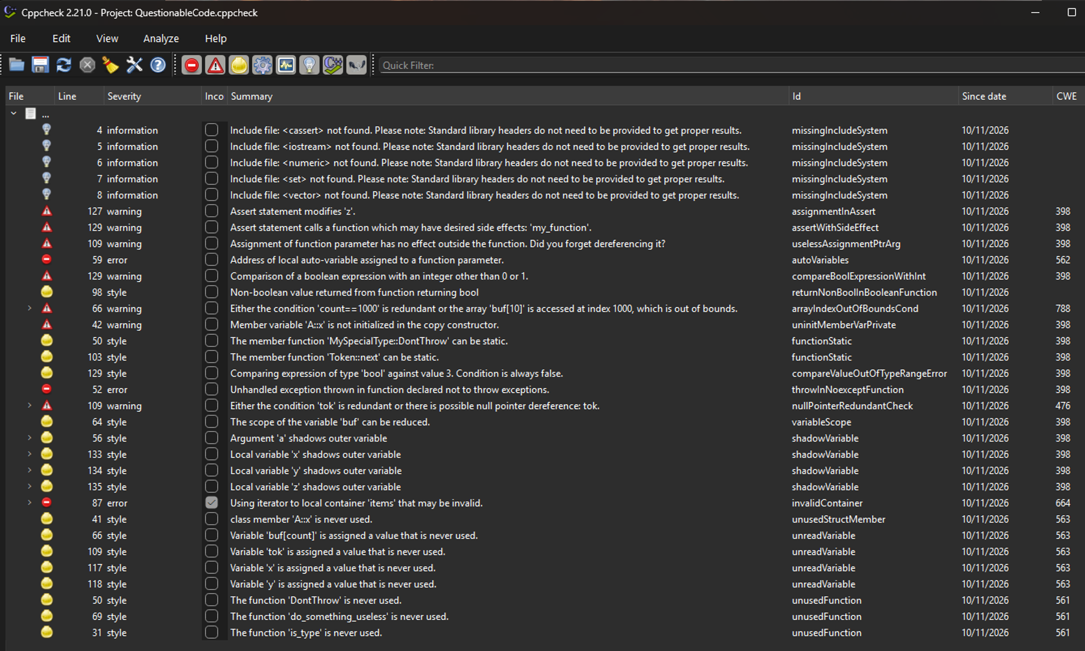
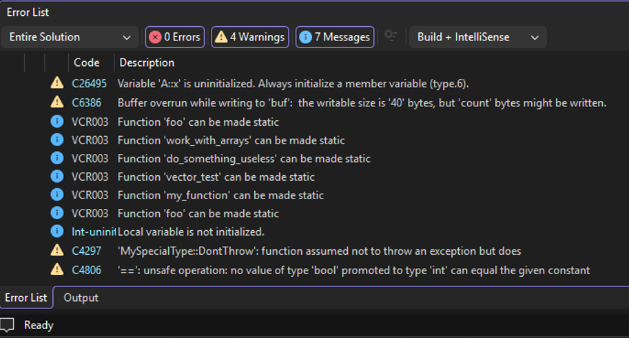
IDENTIFY CODING VULNERABILITIES
Visual Studio Static Code Analysis
Cppcheck 2.21.0
Notes:
On this slide, I'm showing the results from the static code analysis activity I completed in Module Five. I ran the same C++ source code through Cppcheck and Visual Studio to see what each tool would identify.
On the left, Cppcheck version 2.21.0 flagged several potential problems, including out-of-bounds array access, possible null pointer issues, and invalid iterator use. These are important because they can cause crashes, unexpected program behavior, or potentially create security vulnerabilities.
On the right, Visual Studio reported zero errors, four warnings, and seven informational messages. Some of the warnings involved a possible buffer overrun, an uninitialized variable, and exception handling. Even though there were no reported errors, there were still issues that needed attention.
What stood out to me was that the two tools didn't necessarily identify the same problems. Some findings were more serious security concerns, while others were lower-priority code-quality issues.
This also doesn't mean every warning is automatically a confirmed vulnerability. Developers still need to review the results and determine which problems actually need to be corrected.
For Green Pace, I would recommend these types of checks during development and before releasing software. Having multiple tools provides better coverage and gives developers more opportunities to catch vulnerabilities early.

Slide 19
RISKS AND BENEFITS
RISK ASSESSMENT AND PRIORITIES
Prioritize vulnerabilities based on severity, likelihood, remediation cost, and overall risk.
Address high-priority issues first, including signed integer overflow, unsafe string creation from pointers, and unsafe integer conversions.
BENEFITS OF ACTING NOW
Automated testing, static analysis, and code reviews can identify vulnerabilities before release.
Fixing problems early helps reduce security incidents, downtime, and expensive corrections later.
RISKS OF WAITING
Unresolved vulnerabilities can lead to incorrect calculations, unsafe memory access, or exposed information.
Delaying corrections may increase remediation costs and affect business operations or customer trust.
STRATEGY LIMITATIONS AND NEXT STEPS
Automated tools can miss vulnerabilities or generate false positives, while additional checks require time and resources.
Prioritize serious findings, review results manually, and track lower-priority issues for future correction.
Notes:
After looking at the static analysis results, the next question is which security issues Green Pace should address first and what the benefits are of fixing them early.
For my risk assessment, I considered how serious each vulnerability could be, how likely it is to occur, and the cost of correcting it.
Signed integer overflow and unsafe string creation from pointers received the highest threat levels. Unsafe integer conversions also received High priority, even though its threat level was lower. SQL injection is still a serious concern, but its higher remediation cost affected its assigned priority. That doesn't mean a critical vulnerability should be ignored.
One of the biggest benefits of addressing these problems early is catching them before software is released. Automated testing, static analysis, and code reviews can help prevent security incidents and avoid more expensive corrections later.
Waiting too long could lead to incorrect calculations, unsafe memory access, unexpected downtime, or even exposed information. These problems can also affect business operations and customer trust.
There are some tradeoffs, though. Additional security checks take time and resources, and automated tools can sometimes miss vulnerabilities or flag issues that aren't actually security problems.
For Green Pace, I would focus on the most serious findings first, review the results carefully, and keep track of lower priority issues so they aren't forgotten. This helps reduce risk without unnecessarily slowing down development.

Slide 20
RECOMMENDATIONS
IMPLEMENT AUTOMATED SECURITY CHECKS
Gap: The policy recommends automation, but the actual implementation still needs to be verified.
Recommendation: Integrate static analysis and unit testing into the development pipeline, with clear rules for reviewing serious findings.
EXPAND VULNERABILITY COVERAGE
Gap: The ten coding standards address selected C++ vulnerabilities but do not cover every possible security risk.
Recommendation: Add dependency scanning and checks for exposed credentials or secrets.
IMPROVE TRACKING AND REMEDIATION
Gap: Compliance requirements are established, but specific remediation deadlines and performance measures could be better defined.
Recommendation: Assign responsibility for findings, track correction deadlines, and verify that fixes resolve the problem.
CONTINUE DEVELOPER EDUCATION
Gap: Annual policy acknowledgment is required, but ongoing secure coding training could be strengthened.
Recommendation: Provide regular training based on new vulnerabilities, tool findings, and lessons learned from security incidents.
Notes:
At this point, I think Green Pace has a good foundation with its security policy, but there are still a few areas that could be improved as the development team continues to grow.
First, I'd make sure automated security checks are actually being used throughout development. The policy recommends static analysis and unit testing, but Green Pace should verify those checks are being performed consistently and establish a clear process for reviewing serious findings.
I'd also recommend expanding vulnerability detection beyond the original ten coding standards. Those standards cover specific C++ security problems, but they don't address every possible risk. Adding dependency scanning and checks for exposed passwords or other credentials would provide additional protection.
Another improvement would be tracking what happens after a vulnerability is identified. Someone should be responsible for each finding, with reasonable deadlines for correcting it and a way to verify that the problem was actually fixed.
Last, I'd recommend ongoing secure coding training. Green Pace already requires developers to acknowledge the security policy annually, but regular training based on new vulnerabilities and lessons learned would help keep everyone up to date.
I think these recommendations would help Green Pace make sure its security policy is being followed consistently, rather than simply having the requirements written down.

Slide 21
CONCLUSIONS
ADOPT NIST'S SECURE SOFTWARE DEVELOPMENT FRAMEWORK (SSDF)
Use NIST SP 800-218 to establish consistent security practices throughout development, testing, and vulnerability response.
Strengthen procedures for reviewing third-party software and addressing newly discovered vulnerabilities.
APPLY OWASP APPLICATION SECURITY VERIFICATION STANDARD (ASVS)
Use OWASP ASVS to establish additional security requirements for web applications and APIs.
Include verification of authentication, access controls, and input validation.
MAINTAIN AND EXPAND SEI CERT C/C++ CODING STANDARDS
Continue enforcing Green Pace's existing ten secure coding standards.
Review additional CERT rules as new vulnerabilities are discovered and development requirements change.
MOVING FORWARD
Regularly review these standards, verify compliance through testing, and update the policy as security risks evolve.
Notes:
To wrap things up, I think Green Pace has a solid starting point with its security policy, but it will need to keep reviewing and improving it as new threats come up.
One framework I'd recommend is NIST's Secure Software Development Framework, or SSDF. It provides guidance for building security into development and testing, along with addressing newly discovered vulnerabilities and risks involving third-party software.
For Green Pace's web applications and APIs, OWASP's Application Security Verification Standard, or ASVS, could provide additional requirements for areas like authentication, access controls, and input validation.
I'd also keep the existing ten coding standards based on SEI CERT C and C++, while reviewing additional rules as the company's needs and security risks change. These frameworks wouldn't replace the current policy. They would help Green Pace strengthen it over time.
After working through the unit tests and static code analysis, my biggest takeaway is that writing a security policy is only part of the process. The standards need to be followed, tested, and updated for them to actually make a difference.
That concludes my presentation. Thank you for listening.

Slide 22
REFERENCES
OWASP Foundation. (n.d.). OWASP Application Security Verification Standard (ASVS). https://owasp.org/projects/asvs
Seacord, R. C. (2013). Secure coding in C and C++ (2nd ed.). Pearson Technology Group. https://mbsdirect.vitalsource.com/books/9780132981972
Software Engineering Institute. (n.d.-a). SEI CERT C coding standard. Carnegie Mellon University. https://cmu-sei.github.io/secure-coding-standards/sei-cert-c-coding-standard/
Software Engineering Institute. (n.d.-b). SEI CERT C++ coding standard. Carnegie Mellon University. https://cmu-sei.github.io/secure-coding-standards/sei-cert-cpp-coding-standard/
Souppaya, M., Scarfone, K., & Dodson, D. (2022). Secure software development framework (SSDF) version 1.1: Recommendations for mitigating the risk of software vulnerabilities (NIST Special Publication 800-218). National Institute of Standards and Technology. https://doi.org/10.6028/NIST.SP.800-218
Notes:
References Slide – No audio.

